Slide 1
Off field Assistant Sports Analytics
Jaivignesh Rameshbabu
Siddhesh Sawant
Uddhav Patil
Sanman Malvankar

Slide 2
Off field Assistant –Sports Analytics
Problem Statement
Build a adaptive rating system to showcase a winning combination of a cricket team.
Challenges
Analyze Individual player statistics from past ODI data
Understanding the quantifiable causes of this variation such as opponent and venue.

Slide 3
Off field Assistant
Approach
We are going to develop an adaptive-predictive rating system, characterized by utilizing past player performances, and accounting for the long and short term variability of a team’s performance. While considering all the quantifiable causes which impacts success, We can build a overall team rating with respect to individual’s performance, condition, Opponent and venue.

Slide 4
Data Scraping
Data scrapping is done in two ways in order to get the overall team rating by considering Batsman, Bowler and All-rounder individually in to account.
One – Extracting data of the players from past 2 years to get the current form of the players.
Two – Extracting all available data of the players to get their career growth accordingly
Data set source : ESPN cric info :STATSGURU

Slide 5
Data Scraping
Extracting the current form data :
Collecting player’s information with respect to batting, bowling and all. Also with innings list
Using span function to get the specific extended data for 2 years
Creating tables for each feature for easy analysis.

Slide 6
Data Scraping
Extracting career data of the players:
Collecting player’s information with respect to batting, bowling and all. Also with innings list
Considering the whole of data which is not constrained to specific period.
Creating tables and extracting the entire career of the players

Slide 7
Data cleaning
In order to get rid of unwanted data, Data cleaning is done separately for batsman and bowler functions.
Batsman Function:
Remove rows with 'did not bat‘(DNB), Team did not bat (TNDB), Absent and * indicating not out.
Bowler Function:
Remove rows with 'did not bowl‘(DNB), Team did not bowl (TNDB).
“Remove Outliers in both batsman and bowler data using boxplot function”

Slide 8
Data Processing
Time taken by the batsman (few missing data) is predicted using regression function by considering the runs and the balls faced
Strike rate of the batsman (few missing data) is predicted by computing the runs to the balls faced.
Capturing the basic statistics by considering the average,median,min,max runs of the batsman.

Slide 9
Feature Engineering
Extracting the batting indexes and creating the first basic dataframe.
Batting Indexes:
Name,Team and role of the player
Games played
Total runs
Total balls faced
Total dismissals
Total Boundaries
Batting Average
Batting Strike rate
Average contribution
Percentage Boundaries hit
Position bat
No. of wins
Percentage wins

Slide 10
Feature Engineering
Batsman function:
Creating a new data frame for batting Metrics_ Ground wise by considering the new feature, The ground
Creating an another data frame for batting Metrics _Opposition by considering the another feature, The opponent
Data has been processed for batsman function with all sets of data frame

Slide 11
Feature Engineering
Bowler function:
Extracting the bowling indexes and creating the first basic dataframe.
Bowling Indexes:
Name , Team and role of the bowler
Total runs
Total overs
Total wickets
Total maidens
Games played
Economy
Bowling Average
Dot balls
Balls bowled
Percentage dot
Position
No. of wins
Percentage wins
Two other dataframes are constructed based on ground and opponent which is similar to batsman function.

Slide 12
Strategy used
creating player metrics and then ranking the players by creating the Performance Index.
Player Metrics are defined and calculated for Batting as well as Bowling category.
Later these metrics are analyzed together to calculate the Performance Index of the player.
This Performance Index is used to rank the players with respect to their skills.
Thus the Top players are selected as per the requirement in the Playing 11 of the Team.
Index=Variable1*weightage+Variable2*weightage+Variable3*weightage+Variable4*weightage+Variable5*weightage

Slide 13
TECHNIQUES USED
After creating the importance for Batsmen and Bowlers in the squad provided we calculate a number of things.
Dataframes are created to calculate the index value of the players against the opposition using the whole career data.
Dataframes are created to calculate the index values of the players using the current form i.e. the data set of past 2 years.
These 3 indexes are combined to calculate the player value.

Slide 14
Model Building
Career and Current form Data is Iterated from Scraper to create Metrics.
Train the model to find Optimum mtry and ntree
Random Forest is used for finding the Importance Bowling and Batting Data.
Obtaing the Importance Variables using it
Calculating the Indexes for current form and career according to Ground, Opposition and Rank.

Slide 15
Model Building
Data frames are created at the end to define the players with respect to roles like Pure Batsman , WK Batsman , Bowling All rounder and Pure Bowler.
Function PICKTEAM is created to finally select the final playing 11 players from the indexes ranking.
The Captain is selected irrespective of the records where as the above function works for remaining 10 players.
WK is selected after the captain depending if any WK is available in team more than one otherwise the same WK is selected.
Remaining players are selected as per the requirement and as per the Player Index Ranking.

Slide 16
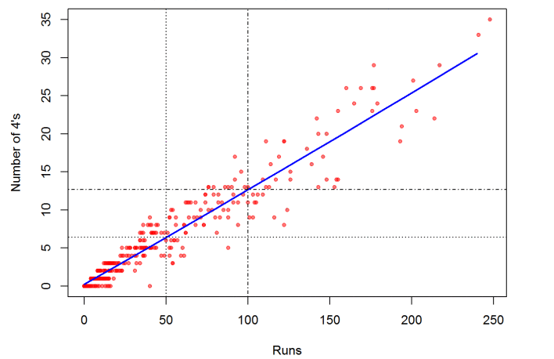
Graphs and Visualisation
VIRAT KOHLI – RUNS SCORED vs No of 4s

Slide 17
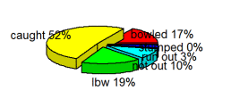
Graphs and Visualisation
VIRAT – Pie Chart of Dismissals

Slide 18
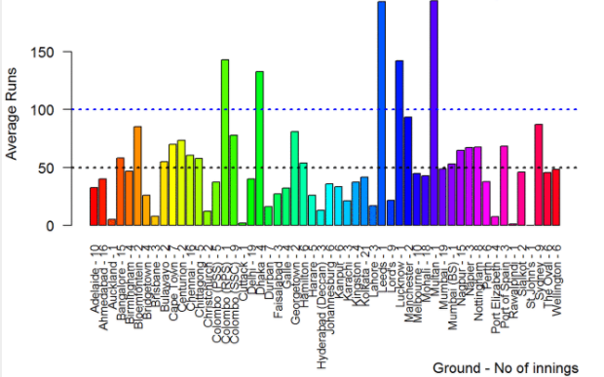
Graphs and Visualisation
KOHLI’s AVERAGE RUNS At Ground

Slide 19
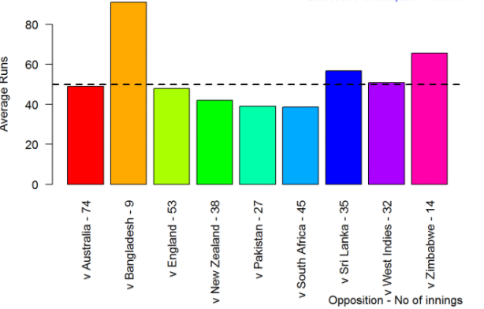
Graphs and Visualisation
KOHLI AVERAGE vs OPPOSITION

Slide 20
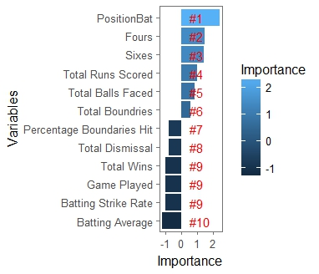
Graphs and Visualisation
BATTING IMPORTANCE

Slide 21
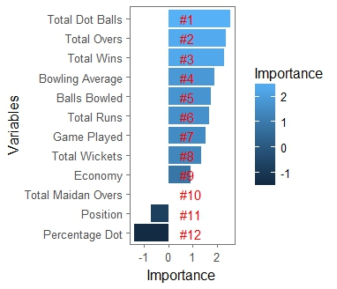
Graphs and Visualisation
BOWLING IMPORTANCE

Slide 22
Conclusion
Thus with the help of STATSGURU , R and Random Forest algorithm we were able to analyze the Best Winning Team for India against the given Opposition.

Slide 23
References
https://gigadom.wordpress.com/2015/07/04/introducing-cricketr-a-r-package-to-analyze-performances-of-cricketers/
http://www.cricmetric.com/blog/

Slide 24

Thank you

